Slide 1
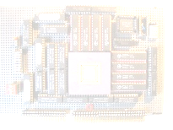
Computation
5Z032
Processor Design
SPIM, a MIPS simulator
Henk Corporaal

Slide 2
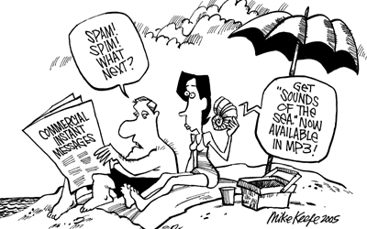
SPIM
Install PCSpim
http://www.cs.wisc.edu/~larus/spim.html
Documentation
  book: appendix A9 (on CD)
  www.cs.wisc.edu/~larus/SPIM/spim_documentation.pdf
Webinterface: http://cgi.aggregate.org/cgi-bin/cgispim.cgi
Alternative to SPIM
  MARS: MIPS Assembler and Runtime Simulator
  http://courses.missouristate.edu/KenVollmar/MARS/

Slide 3
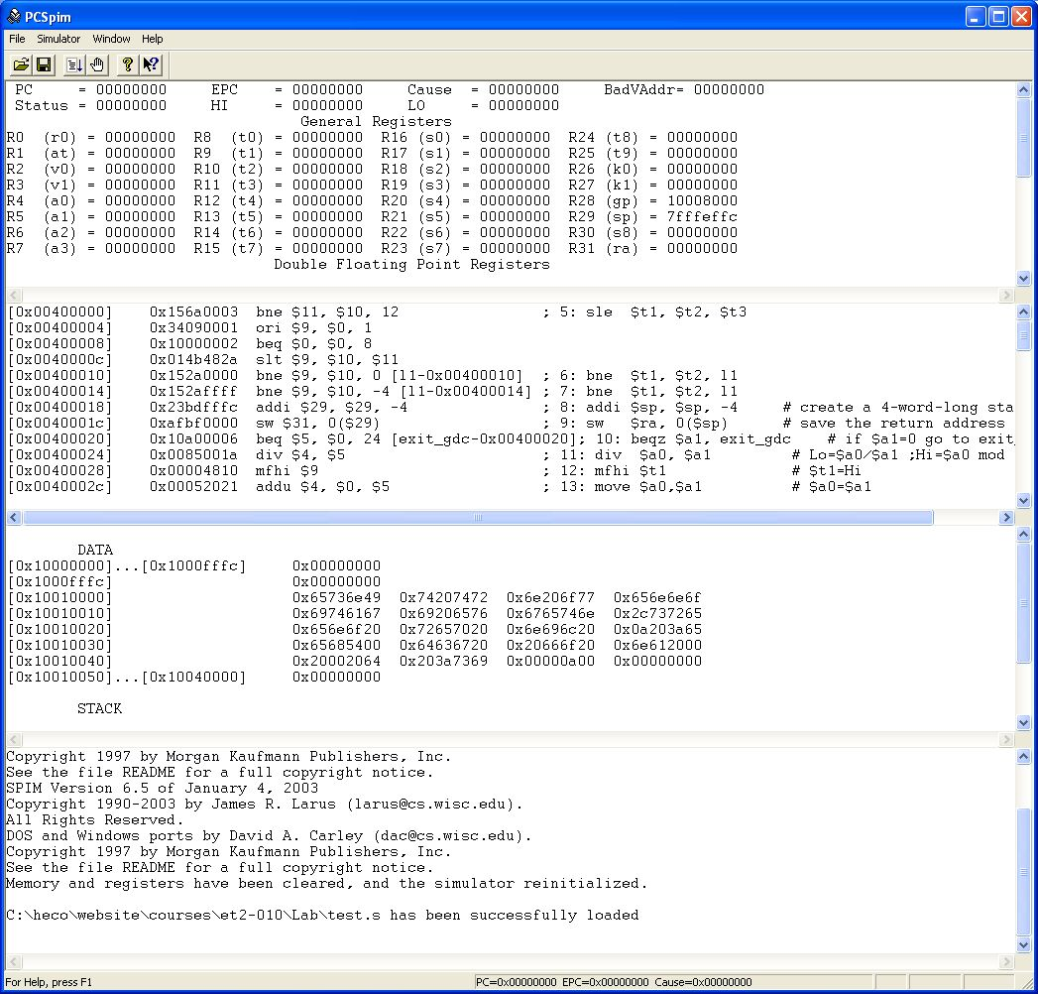
SPIM in action
MIPS registers
Program memory
Data memory
Messages

Slide 4
SPIM example 1: add two numbers
# $t2 - used to hold the sum of the $t0 and $t1.
# $v0 - syscall number, and syscall return value.
# $a0 - syscall input parameter.
.text # Code area starts here
main:
li $v0, 5 # read number into $v0
syscall # make the syscall read_int
move $t0, $v0 # move the number read into $t0
li $v0, 5 # read second number into $v0
syscall # make the syscall read_int
move $t1, $v0 # move the number read into $t1
add $t2, $t0, $t1
move $a0, $t2 # move the number to print into $a0
li $v0, 1 # load syscall print_int into $v0
syscall #
li $v0, 10 # syscall code 10 is for exit
syscall #
# end of main
Assembler directive
starts with a dot
Special SPIM
instruction: system call

Slide 5
SPIM example 2: sum N numbers
# Input: number of inputs, n, and n integers; Output: Sum of integers
.data # Data memory area.
prmpt1: .asciiz "How many inputs? "
prmpt2: .asciiz "Next input: "
sumtext: .asciiz "The sum is "
.text # Code area starts here
main: li $v0, 4 # Syscall to print prompt string
la $a0, prmpt1 # li and la are pseudo instr.
syscall
li $v0, 5 # Syscall to read an integer
syscall
move $t0, $v0 # n stored in $t0
li $t1, 0 # sum will be stored in $t1
while: blez $t0, endwhile # (pseudo instruction)
li $v0, 4 # syscal to print string
la $a0, prmpt2
syscall
li $v0, 5
syscall
add $t1, $t1, $v0 # Increase sum by new input
sub $t0, $t0, 1 # Decrement n
j while
endwhile: li $v0, 4 # syscal to print string
la $a0, sumtext
syscall
move $a0, $t1 # Syscall to print an integer
li $v0, 1
syscall
li $v0, 10 # Syscall to exit
syscall

Slide 6
SPIM/MIPS assembly directives
.data start data segment
.ascii "str" store the string "str" in memory without '\0'
.asciiz "str" idem, with '\0'
.byte 3,4,16 store 3 byte values
.double 3.14, 2.72 store 2 doubles
.float 3.14, 2.72 store 2 floats
.word 3,4,16 store 3 32-bit quantities
.space 100 reserve 100 bytes
.text start text segment

Slide 7
SPIM syscall examples
Service | Trap code | Input | Output
print_int | $v0 = 1 | $a0 = integer to print | prints $a0 to standard output
print_float | $v0 = 2 | $f12 = float to print | prints $f12 to standard output
print_double | $v0 = 3 | $f12 = double to print | prints $f12 to standard output
print_string | $v0 = 4 | $a0 = address of first character | prints a character string to standard output
read_int | $v0 = 5 |  | integer read from standard input placed in $v0
read_float | $v0 = 6 |  | float read from standard input placed in $f0
read_double | $v0 = 7 |  | double read from standard input placed in $f0
read_string | $v0 = 8 | $a0 = address to place string, $a1 = max string length | reads standard input into address in $a0
sbrk | $v0 = 9 | $a0 = number of bytes required | $v0= address of allocated memory Allocates memory from the heap
exit | $v0 = 10
print_char | $v0 = 11 | $a0 = character (low 8 bits)
read_char | $v0 = 12 |  | $v0 = character (no line feed) echoed
file_open | $v0 = 13 | $a0 = full path (zero terminated string with no line feed), $a1 = flags, $a2 = UNIX octal file mode (0644 for rw-r--r--) | $v0 = file descriptor
file_read | $v0 = 14 | $a0 = file descriptor, $a1 = buffer address, $a2 = amount to read in bytes | $v0 = amount of data in buffer from file (-1 = error, 0 = end of file)
file_write | $v0 = 15 | $a0 = file descriptor, $a1 = buffer address, $a2 = amount to write in bytes | $v0 = amount of data in buffer to file (-1 = error, 0 = end of file)
file_close | $v0 = 16 | $a0 = file descriptor

Slide 8
SPIM example 3: GCD
E.g. GCD (30,18) = 6
C code:
int gcd(int a, int b) {
if (b == 0)
return a;
else
return gcd(b, a % b); // recursive call
}
void main(void) {
int a, b;
printf("Enter a and b: ");
scanf("%d%d", &a, &b);
printf("gcd(%d, %d) = %d\n", a, b, gcd(a, b));
}

Slide 9
MIPS / SPIM assembly program of GCD
.text
gcd : addi $sp, $sp, -4 # create 4-word-long stack frame
sw $ra, 0($sp) # save the return address
beqz $a1, exit_gcd # if $a1=0 go to exit_gcd
div $a0, $a1 # Lo=$a0/$a1 ;Hi=$a0 mod $a1
mfhi $t1 # $t1=Hi
move $a0,$a1 # $a0=$a1 (pseudo assembly instr.)
move $a1,$t1 # $a1=$t1
jal gcd # recursive call to gcd
exit_gcd:
move $v0, $a0 # $v0=$a0
lw $ra, 0($sp) # restore the return address
addi $sp, $sp, 4 # adjust stack pointer
jr $ra # return to caller
Q: Why do we not need to save the arguments $a0 and $a1 on the stack?
Note we could have optimized above code using tail-recursion.

Slide 10
Strange MIPS instructions
div $t1, $t2
mult $t1, $t2
These instructions seem to have no explicit destination register!
ALU / MUL / DIV
Control
Hi
Lo
Integer register file
containing 32 registers
32-bit
mflo $t1
mfhi $t1
mtlo $t1
mthi $t1
32-bit

Slide 11
MIPS assembly program of GCD: main
.data
str1: .asciiz "Give 2 nonnegative integers, 1 per line: \n"
str2: .asciiz "The gcd of "
str3: .asciiz " and "
str4: .asciiz " is: "
str5: .asciiz "\n"
.text
main: addi $sp, $sp, -4 # create a stack frame
sw $ra, 0($sp) # save the return address
again: la $a0, str1 # a pseudo assembly instruction
li $v0, 4 # print of str1; also pseudo
syscall #
li $v0, 5 # get the first number
syscall # and put it in $v0
move $s0, $v0 # $s0=$v0
bltz $s0, again # if $s0<=0 go to again

Slide 12
MIPS assembly program of GCD: main
(cont'd)
...
move $a0, $s0 # $a0=$s0
move $a1, $s1 # $a1=$s1
jal gcd # go to gcd
move $t0, $v0 # $t0=$v0
...
la $a0, str5 #
li $v0, 4 # print of str5
syscall #
lw $ra, 0($sp) # restore the return address
addi $sp, $sp, 4 # eliminate the stack frame
jr $ra # return to caller

Slide 13
SPIM in action
MIPS registers
Program memory
Data memory
Messages

